Slide 1
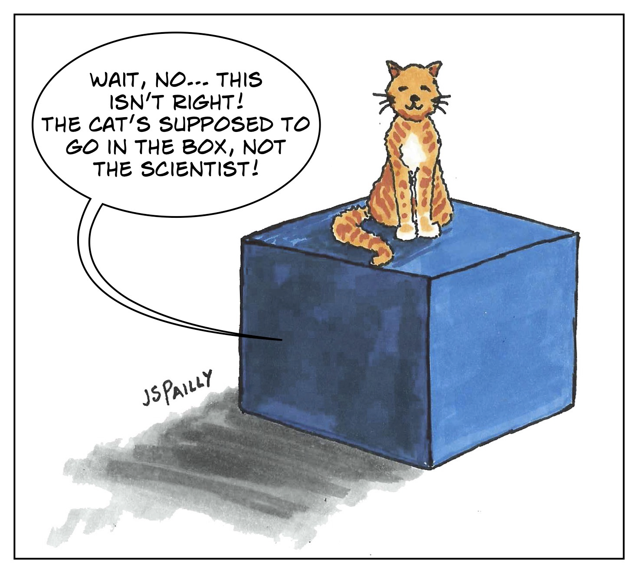
Software Architecture and Quantum Computing
https://planetpailly.com/2019/05/17/sciency-words-schrodingers-cat/

Slide 2
What is Quantum Computing?

Slide 3
Quantum Mechanics
It’s all about probability – and uncertainty.
  The more precisely the position is determined, the less precisely the momentum is known in this instant, and vice versa.
  Werner Heisenberg
Quantum mechanics is the best tool we have to understand how the universe works on its smallest scales. Everything we can see around us, from far-off galaxies to our own bodies, is made up of subatomic particles, unimaginably tiny entities whose interactions produce the macroscopic effects we experience day-to-day. While it’s tempting to imagine that these interactions obey the laws of physics that we’re familiar with in our everyday lives, they are actually much much stranger.
The New Scientist

Slide 4
The very brief history of Quantum Computing
1982: Richard Feynman discusses the idea of a machine that would operate on Quantum Mechanical Principles. Create a Quantum System to monitor another Quantum System, a Quantum Simulator
1985: David Deutsch proposes the idea of a Quantum Turing Machine and provides an algorithm to run such a device. A model of a Quantum Computer
1994: Peter Shor proposes the first killer app for Quantum Computing, an algorithm that factorizes large number to their prime number counterparts exponentially faster than current computers.
In essence – a Quantum Computer would be able to break current encryption algorithms
At this point in time it’s all theory – no one has figured out how to build a Quantum Computer

Slide 5
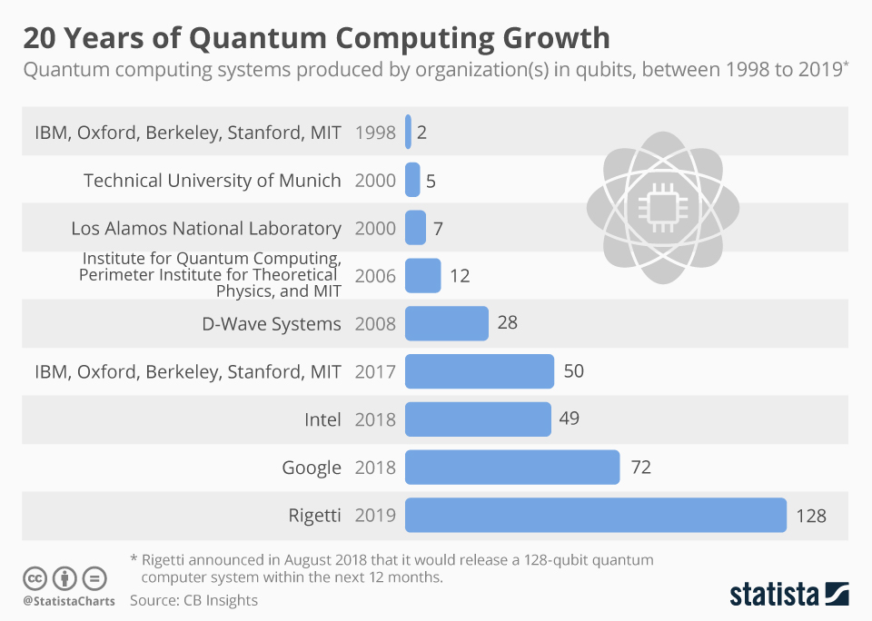
The very brief history of Quantum Computing
1998: The first quantum computer (2-qubit) that could be loaded with data and output a solution. Although their system was coherent for only a few nanoseconds and trivial from the perspective of solving meaningful problems, it demonstrated the principles of quantum computation.

Slide 6
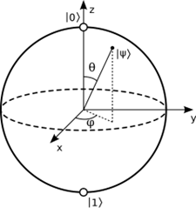
Birth of the Quantum Computer
Two methods of creating Quantum Computers are developed:
  Trapped Ions
  Artificial Atoms – created by superconducting circuits
  This leads to the creating of the needed infrastructure:
    Qubit: A quantum bit, the physical carrier of quantum information
      Consists of three components
        Probability the value is 1
        Probability the value is 0
        Phase, a ‘rotation’ of the qubit

Slide 7
Quantum Computing Basics
Basic Concepts
Superposition: Can be thought of as an equation that has more than one solution. When we solve x² = 4, x can either be 2 or –2. In Quantum Computing, a qubit can either be observed as being a 0 or 1 but that value is the combination of the probability of being 1 and the probability of being 0.
Entanglement: A phenomenon in which the quantum states of two or more objects become correlated, meaning that the state of one object can affect the state of the other(s) even if the objects are separated by large distances
Interference: When subatomic particles interact with and influence themselves and other particles while in a probabilistic superposition state.

Slide 8
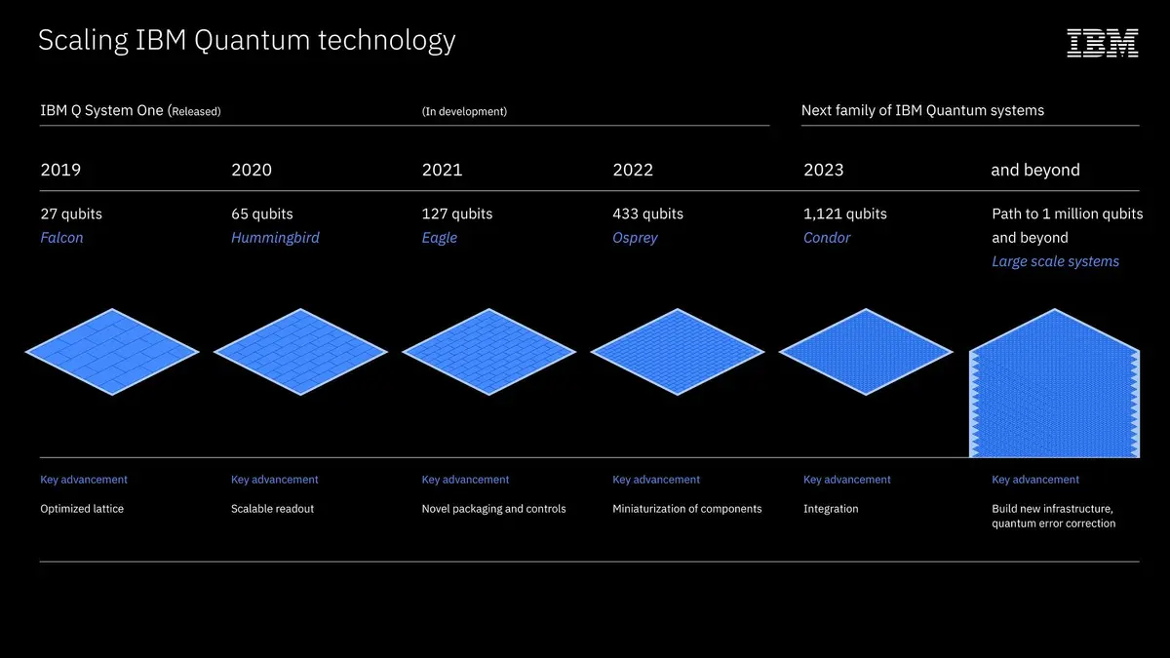
IBM’s Quantum Computer Roadmap
https://research.ibm.com/blog/ibm-quantum-roadmap

Slide 9
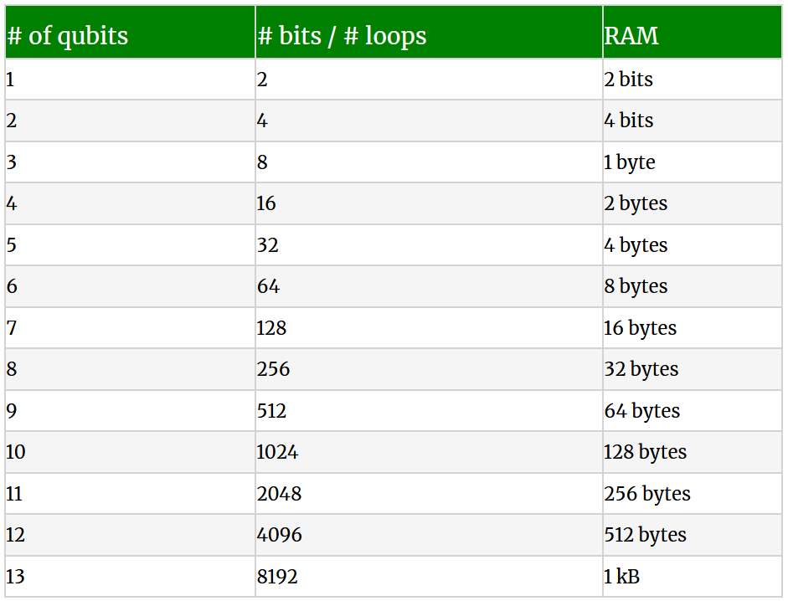
What Changes with Quantum Computing?
13 qubits hold the same amount of information as 8192 classical bits – or 1K Bytes of memory.
https://vincentlauzon.com/2018/03/21/quantum-computing-how-does-it-scale/

Slide 10
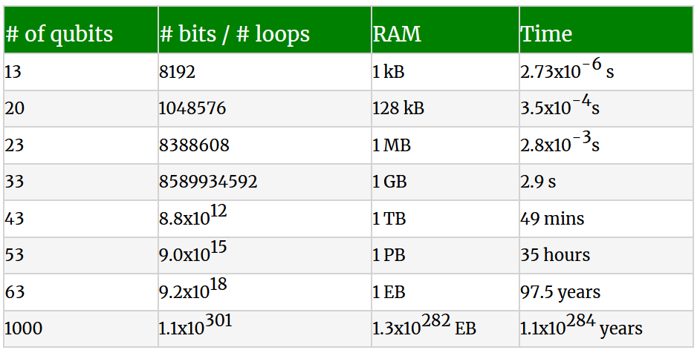
What Changes with Quantum Computing?
Continuing those calculations and adding in the time* it takes a classical computer to the operation of a collection of qubits
* For time we’re assuming 3 Billion operations per second
https://vincentlauzon.com/2018/03/21/quantum-computing-how-does-it-scale/

Slide 11
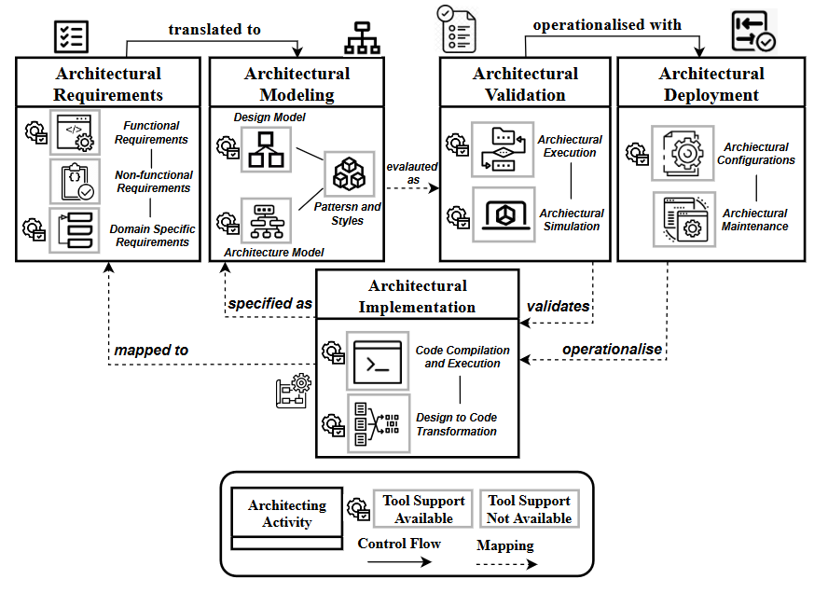
Architectural Process

Slide 12
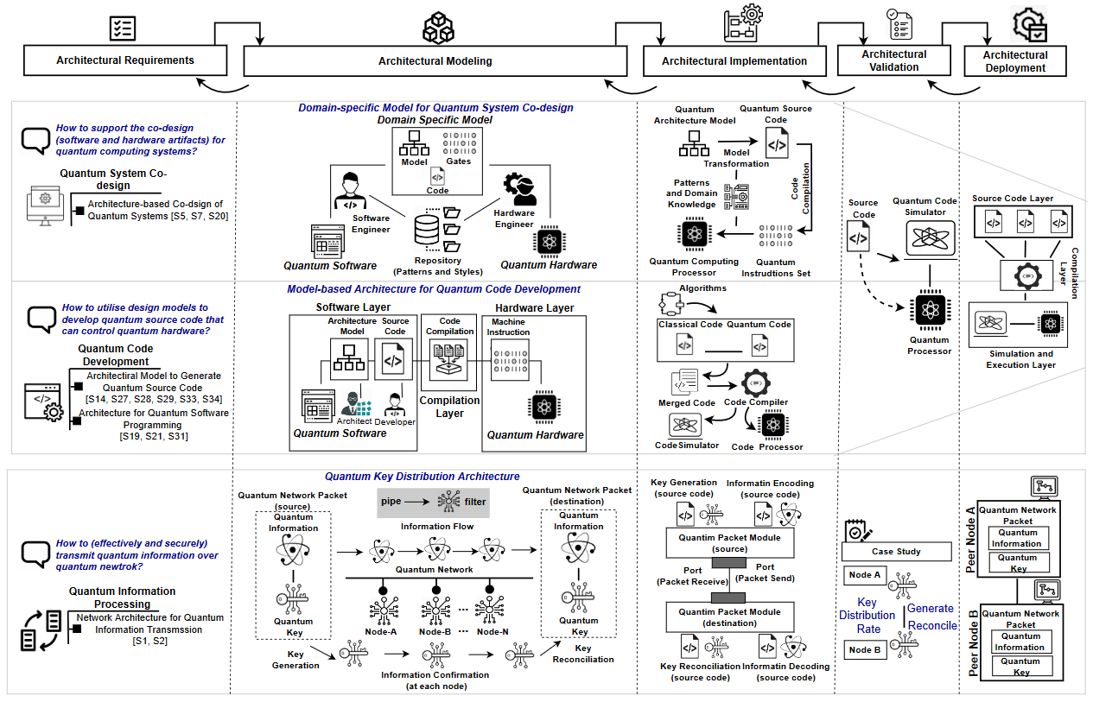
What New Problems Exist?
Software Architecture for Quantum Computing Systems – A Systematic Review

Slide 13
More Problems
The specification, verification, and debugging of quantum programs is an extremely difficult problem:
  Complexity of QC software and hardware makes their correct design extremely difficult
  Intractability of QC simulation limits the amount of predesign testing and simulation available to developers
  The nature of QC systems is that measurement collapses the state; therefore, conventional debugging methods based on measuring program variables during program execution would disrupt execution and so cannot be used
Quantum Computing: Progress and Prospects (2019)

Slide 14
Patterns for Quantum Computing
Layered Pattern:
Pipe and Filter Pattern:
Composite Design Pattern
Prototype Design Pattern
Recursive Containment
Two-Qubit Gate Pattern

Slide 15
What is the path to integrate Classic and Quantum Computing?

